Slide 1
Working with students as partners
Louise Walker
Department of Mathematics

Slide 2
Students as Partners (SaP)
A pedagogical approach that involves students and academic/support staff working collaboratively to improve teaching, learning and the student experience.
Rather than a ‘you said, we did’ approach, there is an ongoing dialogue between students and staff.
SaP should be based on ‘respect, reciprocity and shared responsibility in learning’.
(Engagement through partnership: students as partners in learning and teaching in higher education, Healey M., Flint A. and Harrington K., Higher Education Academy)

Slide 3
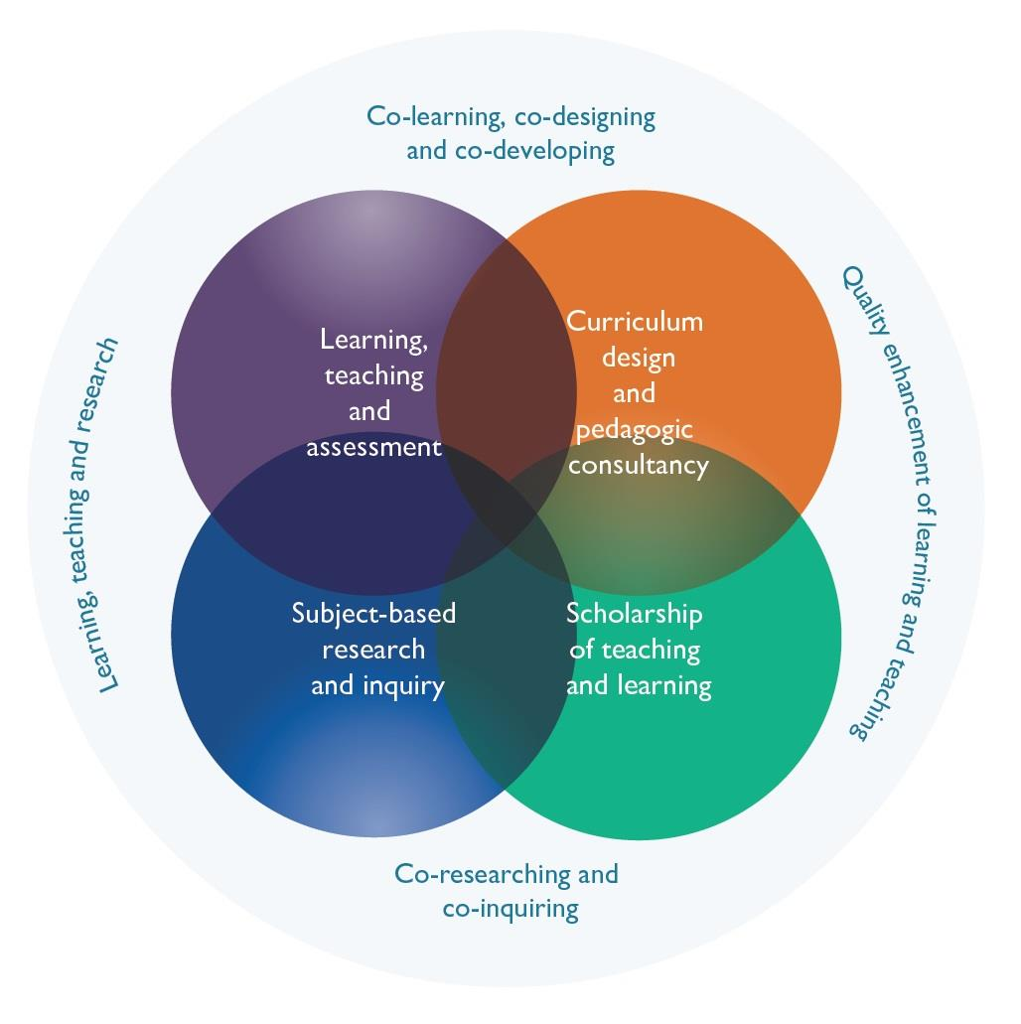

Slide 4
SaP
PASS (Peer Assisted Study Sessions)
Smarter Curriculum project (with Zainab Mahmood, Caroline Bowsher)
Working with students to develop
blended learning guidance (with student reps)
student workload model for coursework (with Kai Prince)
assessment and feedback literacy guidance (with Sophie Marshall)
Co-creation of How to Study Maths sessions

Slide 5
Student Partner: Sophie Marshall
Student Experience Internship (6 weeks in summer 2023) focusing on assessment literacy and feedback within our undergraduate mathematics programmes.
Created and distributed a survey investigating student views about feedback, as well as assessment and study methods.
Partnered with teaching staff to advise on How To Study Maths sessions which will be delivered to incoming first years.
Created student-written and survey informed guidance about where feedback can be found, how to use feedback, and how to incorporate active feedback into learning.

Slide 6
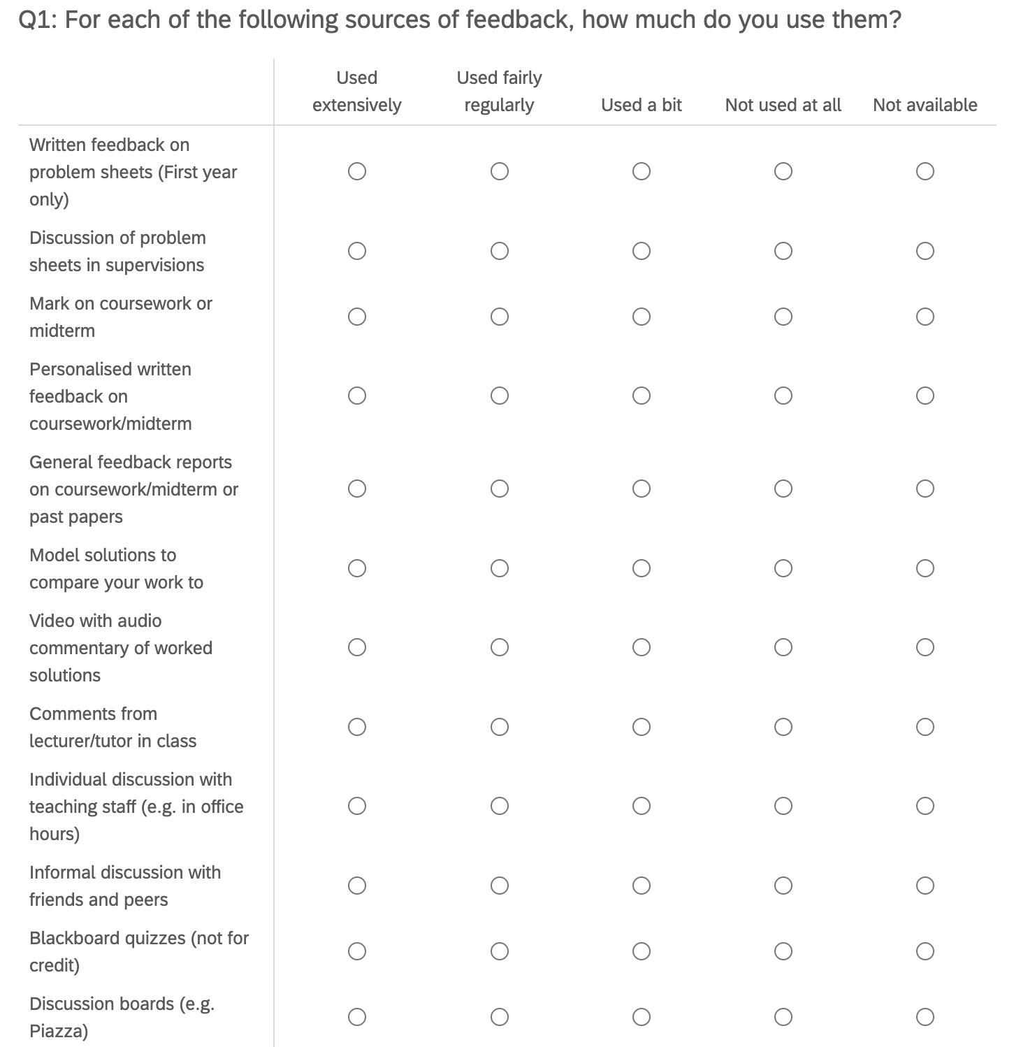
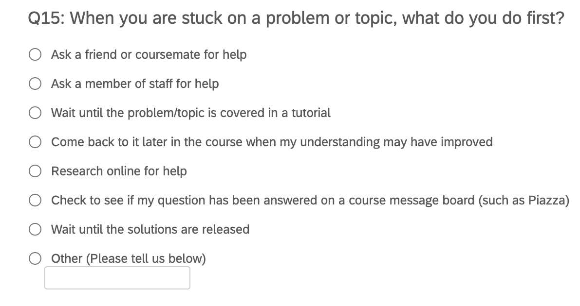
Survey Questions
Some examples…

Slide 7
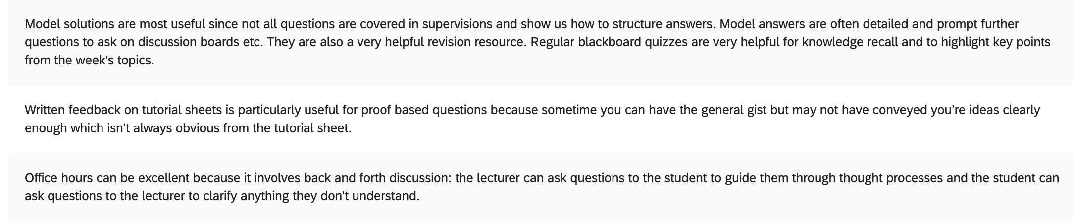
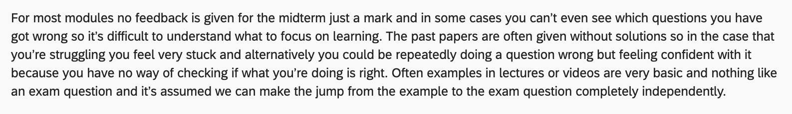
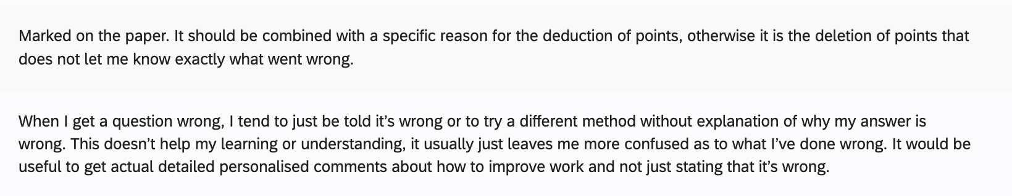
Survey Responses
(Explain why you have rated some types of feedback particularly positively/negatively)

Slide 8
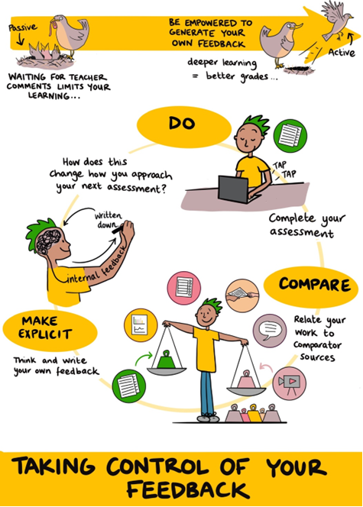
Feedback guidance
Section 3: Problem-solving and active feedback through comparison
The problems you will be set at university can be quite different from the sorts of problems you might be used to from school or college. They are designed to be challenging and develop your ability to solve problems, reason mathematically, and develop a deep understanding of the content you are taught. This section contains advice for tackling problem-solving at university, followed by a method of generating feedback on your own work through comparison, a process called Active Feedback (Jennifer Rose). Active feedback consists of three steps: Do, Compare, and Make Explicit. The idea is that you complete a piece of work, compare it to something (like a peer’s work or a model solution), and then make explicit your comparisons by answering some comparative questions.
Figure 1: Active Feedback for Students (Jennifer Rose)

Slide 9
Thanks
Any questions?
louise.walker@manchester.ac.uk

