Slide 1

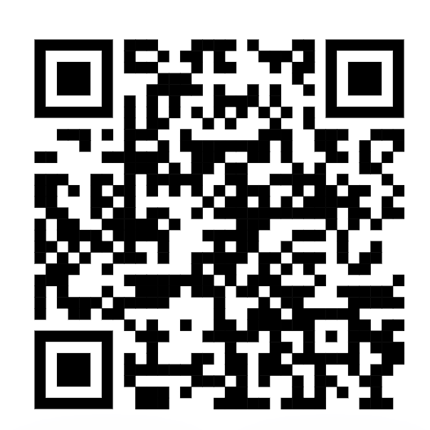
Please confirm your attendance for today’s session
Scan the code..
Or
Got to the URL https://tinyurl.com/FSENAP
Enter the Secret Word - apple

