Slide 1



Deep Learning Through Constructive Alignment
Fiona Velez-Colby FHEA
Lecturer in Fashion Retail Technology
Janine Dixon FHEA
Lecturer in Garment Technology
A Critically Reflective Case Study of Group Learning and Student Engagement.
Notes:
FIONA read
Good morning, our talk is a reflection on our experiences of Deep Learning Through the Constructive Alignment of group learning in seminars and their impact on engagement in lectures.
My name is Fiona and I’m Lecturer in Fashion Retail Technology, teaching across UG and PG and covering retail and marketing. My research interests include fashion sustainability and higher education pedagogy.
JANINE read
Janine intro – Lecturer in Garment technology, teaching on the undergraduate programmes covering garment technology and fashion buying. My research interests are education for sustainable development and widening participation for neurodivergent students.

Slide 2


Purpose
Engagement
Do students engage more deeply with group work when linked to assessment, than when simply meant to deepen knowledge and understanding?
A comparative study of online and on-campus studies:
This research considers how group learning strategies can impact on student engagement, experiences, and outputs.
Experience
Is the student’s learning journey enhanced through utilising group activities to encourage participation learning?
Outputs
Are the student’s outputs enhanced through group learning and participation?
Notes:
FIONA
This presentation is a reflection of the second phase of our exploratory qualitative study where we examine and critically reflect on our students’ engagement in two different group learning settings on the Materials Fashion Business Technology UG programme.
We are comparing group learning activities delivered in the small group seminars which are designed to be constructively aligned with the lecture content delivered to the whole cohort.
Our ongoing research aims are to identify how particular group learning strategies can positively impact on our students’ engagement, their experiences, and outputs.
We have three specific hypothesis which formed the framework of our analysis…(read them)

Slide 3

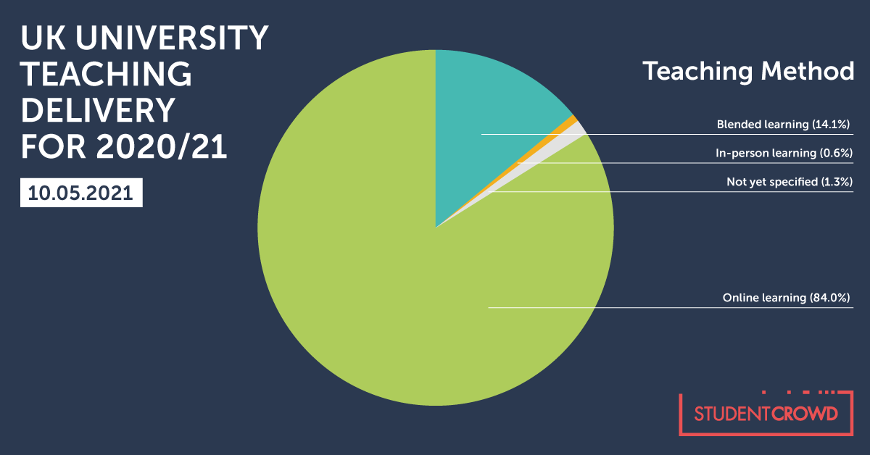
The Timeline
Traditional On Campus Methods
(Followed by very abrupt move to 100% online delivery in March 2020)
2019
/2020
2020
/2021
Stage 1:
Online Delivery due to Covid-19
2021
/2022
Stage 2:
Blended Learning
Figure 1. UK University Teaching Delivery for 2020/21 (Bena, 2021)
Figure 2. Delivery Method Timeline. (Authors own, 2021)
Notes:
JANINE
For the 20/21 academic year, all our teaching and learning for the Fashion Business Technology course was delivered exclusively online due to government Covid restrictions.
We used a combination of asynchronous materials on Blackboard, and synchronous activities such as: large cohort lectures, smaller group seminars, workshops and tutorials, delivered via Zoom.
Similar to the experiences of many other lecturers, we found that student engagement has peaked and troughed across the different learning environments and we have found maintaining student engagement in online settings proved challenging.
In 21/22 we returned to on-campus teaching but with blended learning, keeping the asynchronous flipped learning resources on blackboard, but returning to on-campus teaching for all lectures, seminars and workshops.
In this presentation we will review the engagement, experiences and outputs across the two different years of online and on campus experiences.

Slide 4
Overview of Units
Sourcing and Distribution
Brand Management
1
2
Group activities structured to increase active participation learning through common goal group work (Benek-Rivera & Matthews, 2004; Mills-Jones, 1999)
and away from the passive learning style of traditional lectures
(Michael et al., 2004).
Study Level
Semester
Optional Unit
Summative Assessment
5
2
Yes
100% Exam
5
2
Yes
50% Group Coursework / 50% Individual Coursework
Figure 3. Similarities of the selected FBT units. (Authors own, 2021)
Notes:
FIONA
We are using 2 units which are as similar as possible, including study level and semester delivery ( as shown here on the slide), to enable meaningful comparison, and the main point of difference is the summative assessment type.
Both units have a strong focus on active participation group activities and aim to move away from the passive learning style of traditional higher education.

Slide 5
Sourcing and Distribution
12 week unit. 10 credits
Assessment:
100% Examination
Groups of 3-5 students, formed impromptu during the sessions
Weekly Delivery:
1 hour of pre-recorded lectures
Additional Fortnightly Delivery:
1 hour small group lecture
1 hour small group seminar
GROUP WORKING DETAILS:
Groups of 3 or 4 students create a short PowerPoint presentation.
New groups are formed for each seminar.
Students are not required to conduct any work outside of the seminar.
Attendance informally monitored
Notes:
JANINE
In the Sourcing and Distribution unit the students are assessed through a 100% examination at the end of the semester.
Weekly topics are delivered through asynchronous recordings on Blackboard, and followed by fortnightly live lectures and seminars.
The seminar task required the students to work in groups of 3 to 5 to create a short PowerPoint presentation on various themes which are set by the teaching staff.
Students can choose which of the themes they wanted to work on and the groups are formed from this.
The themes change each seminar, so do the groups.
During the seminar the students are given the first 30 minutes to create their PowerPoint. Then present their work to the rest of the cohort.
For this 10-credit unit the students are not required to conduct any group work outside of the seminar, and attendance is informally monitored by the tutor.

Slide 6
Brand Management for Fashion
12 week unit. 20 credits
Coursework Assessment:
50 % Group Project worth 50% of unit
14 groups of 4-5 students for duration of 7 week project of the 12 week unit
Weekly delivery :
1 hour of pre-recorded lectures
1 hour lecture
1 hour small group seminar
GROUP WORKING DETAILS:
Students given the opportunity to chose their groups
Expectations of group working conditions were formally agreed at the start.
Seminars provided students with weekly opportunities to meet as a group
Attendance informally monitored
Each group gets 2 individual group feedback tutorials with the tutor
Notes:
FIONA
On the Brand Management for Fashion unit the Group work output forms 50% of the students unit mark and runs for 7 weeks of the 12 week unit.
For the summative assessment the students need to produce a 4500 word market and brand analysis report, a decent sized project for a 20 credit unit. They are given the opportunity to chose members of their group with 2, 3 or 4 other students. Some take up the offer, others specifically request to be placed in random groups – there is no evidence that group make-up impacts on the quality of the output or the effectiveness of the groups in either 20/21 or 21/22.
In the first week, each group of students produced a group working agreement which covered with issues like workload, roles and responsibilities, communication channels, working hours, to help manage expectations.
In the weekly 1 hour small group seminars the students are given the chance to practice and get feedback on a key aspect of their project as well as have a group meeting.
Additionally all the groups have 2 opportunities to have a group feedback tutorial with me during the project.

Slide 7
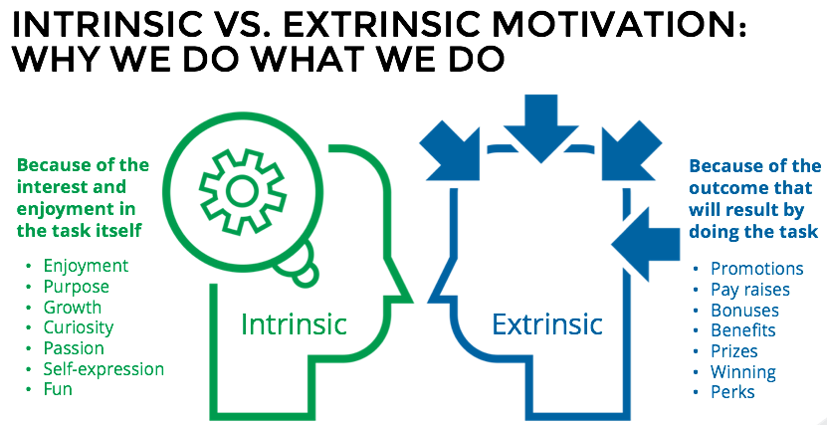
Intrinsic and Extrinsic Motivations
The research and reflection is driven by a desire to create sessions which foster active learning methods over traditionally passive delivery (Büchele, 2020)
To develop Communities of Practice (Wenger, 1998)
Through group activity design we hope to encourage both intrinsic and extrinsic motivation and recognise the importance of both
Notes:
JANINE
Our research and reflection is driven by our desire to create sessions which foster active learning methods over traditionally passive delivery methods
Through our critical reflections of these different group activities we noticed that we were encouraging either intrinsic or extrinsic motivation factors through their design.
In the sourcing and distribution unit the delivery design focusses on intrinsic rewards in the form of the students’ enjoyment, purpose, and growth when learning and applying their new skills.
FIONA
In the Brand Management unit the students work towards an extrinsic reward in the form of their group coursework grade, but also gain the same intrinsic rewards as part of the learning journey.

Slide 8
UEQ Student Feedback
“People were actually talking with each other and we learnt something new thanks to them.”
“The live sessions were interactive and it helped gather knowledge.”
“[The] seminars [were] very interactive which was really nice as a lot of online seminars have not been.”
“Pushing us to present our work in seminars helped with confidence.”
20/21
Sourcing and Distribution
Notes:
JANINE
First looking at the sourcing and distribution unit (or rather the intrinsic reward of group work) during 20-21, the year of online teaching and government restrictions, we found that the students engaged with the seminar activities and enjoyed the process of learning without a defined external reward.
The attendance for the lectures and seminars were consistently high throughout the 12 week unit, with no obvious disparity between the numbers attending the lecture vs the seminar.
Within the seminar sessions all students actively engaged in the creation and presentation of the work.
From the Unit Evaluation Questionnaire feedback we found that students valued the experience of active learning within the seminar as well as the experience of learning together - as you can see in the feedback comments.
All groups worked well together, creating and presenting informative presentations. There was no evidence of a lack of contribution from any members, and there was no disparities in the quality of the outputs between groups which contained friendships compared to those which did not.
We were also impressed with the final exam results in which students showed a clear understanding of the topics along with evidence of further reading.

Slide 9
20/21
Brand Management for Fashion
Many groups met with each other (virtually) outside of the seminars, most at least once or twice every week.
International exchange students used this as a way to make new friends.
Some groups experienced teething problems with participation, communication and expectations occurred in the early stages, but were easily resolved.
The standard of outputs was extremely high, and incorporated aesthetic qualities seen in industry publications as well as high academic qualities.
Notes:
FIONA
On the Brand Management unit, in 20-21, the seminar attendance was extremely high throughout with many weeks at 100% attendance and in the few instances of missed sessions I found that students either emailed me and the GTA delivering the seminar or someone in their group emailed me and the GTA. I think this demonstrates the students commitment to the project and also their respect for their teammates.
I held individual group feedback tutorials twice in the 7 weeks – and I used these tutorials to check on the progress of the projects, but importantly to check on the ways in which the students were working as a group (as this formed part of the assessment)
These tutorials informed my reflections of the student’s experiences and from this I was able to get extensive feedback as to how they were finding working together.
On reflection I noticed that students were meeting virtually in addition to the seminars, that the seminars and the group work provided them with opportunities to build friendships, that online communication facilitated problem-solving, and that the outputs were both academically and professionally of a very high standard.
In the remaining 5 weeks after the group project finished the seminar attendance for the rest of the unit dropped significantly for the remaining 5 weeks, however lecture attendance remained at a similar high level to the first half of the unit.

Slide 10
21/22
Sourcing and Distribution
Student engagement for the intrinsic group learning seminars has dropped significantly
Due to the low attendance in the seminars it is not possible to continue with the planned group learning activities some weeks.
40-50% of the students are attending the lectures and those who do attend actively engage in the discussions.
The attendance monitoring system has created barriers to identifying reasons for none attendance.
Notes:
JANINE
Since returning to on campus teaching this year the sourcing and distribution unit lectures have been timetable for a Thursday at 2pm with the seminars on Friday at 3pm.
the student engagement for the intrinsic group learning seminars has dropped significantly with attendance as low as zero on the last day before the Easter break. Due to the low attendance in the seminars it is not possible to continue with the planned group learning activities some weeks and instead the small number of students in attendance actively engage with open discussions of the topics led by the TA.
40-50% of the students are attending the lectures and those who do attend actively engage in the discussions with the lecturer and say they are enjoying the unit topics despite no attending the seminars.
Using the attendance monitoring system to identify the regular none attenders, I have reached out to these students to ask if there are barriers affecting their ability to attend the seminars or if there are any issue with the unit. Those who did respond to the emails have said that they are happy with the unit.
Some of the respondents also said that they did attend the session but forgot to check in! And since then these students are checking into the seminar sessions but still not attending.

Slide 11
Far fewer groups met with each other outside of the seminars, with only approx. 50% meeting once a week.
Participation, communication and expectations issues were more difficult to resolve as students were not so able to communicate digitally and were reliant on the seminars to meet their fellow teammates.
Monitor attendance and group participation in the offline spaces is problematic
For many of the groups the standard of outputs was still extremely high, and incorporated aesthetic qualities as well as high academic qualities.
21/22
Brand Management for Fashion
Notes:
FIONA
Since returning to on-campus teaching this year the brand management unit lectures have been timetable for Thursday at 10am with the seminars on Fridays at either 9am, 10am or 3pm – the timeslots on Friday appears to have no meaningful impact on attendance during the group project.
Lecture attendance for the first half of the unit, during the group project has fluctuated between 50% and 75%. The lectures have been used to discuss the topics raised in the pre-recorded asynchronous materials, but mostly to introduced new concepts and as a space to discuss aspects of the group work and for the students to ask questions about the group project.
Seminar attendance during the group project was informally monitored and shows similar attendance levels of around 50-75%. Interestingly during online delivery in 20-21 the group feedback tutorials had 100% group attendance with only one or two students in the entire cohort not attending. This year there were several groups who did not attend one or both of the feedback tutorials.
Again I held individual group feedback tutorials twice in the 7 weeks, and as before, I used these tutorials to check on the progress of the projects and to check on the ways in which the students were working as a group and I have formed my reflections of the student’s experiences from these tutorials…
I have noticed that this year… (READ SLIDE)
After the group project finished it appears that the lecture and the seminar attendance has dropped significantly with the other tutor delivering on the unit reporting attendance as low as 10% for the lectures and some seminars with 5% attendance.

Slide 12

Stage 1 Findings:
Online Setting
Stage 2 Findings:
On-campus Setting
Engagement
Students’ levels of engagement with group activities were not linked to assessment.
Engagement
Students’ levels of engagement with group activities are linked to assessment.
Experience
The student’s learning journey was enhanced through utilising group activities that required active participation and enabled them to learn collaboratively and build relationships.
Experience
The student’s learning journey is enhanced through utilising group activities, however collaborative and participation is key.
Outputs
The student’s achievements were deepened through active group learning whether for intrinsic or extrinsic reward.
Outputs
The student’s achievements are deepened through active group learning but this is motivated by extrinsic reward.
Notes:
JANINE
In our research we are considering how group learning strategies impact on students’ engagement, experiences, and outputs.
READ SLIDE...

Slide 13

Final Reflections
Students’ levels of engagement with group activities appear to be greatly impacted by the environmental factors that are beyond our control.
In exclusively online settings students valued their learning journey and found peer learning in small class settings being very rewarding.
Since returning to campus teaching, we have found that participation in group activities is linked to the extrinsic reward provided by group summative assessment.
We continue to advocate collaborative and group learning within the teaching delivery, but recognise the need to research into alternative delivery methods in order to improve student attendance and engagement.
Notes:
FIONA
In our critical reflections of these two units at very different points in time, the most significant finding we have identified is that the students’ levels of engagement with group activities appear to be greatly impacted by environmental factors that are beyond our control.
Online we found that the student’s learning journey was greatly enhanced through using group activities. By removing the ability for our students to be passive and creating small class-size settings which required active participation, we enabled our students to become actively engaged in their online learning environments, with these scenarios enabled them to learn collaboratively and build relationships at a time when they were craving community and shared experiences in virtual spaces.
On-campus we found that participation in the small class-size group activities was very closely linked to extrinsic reward and that students were no longer needing community and shared experiences in these on-campus spaces. This created an enormous barrier as it was very difficult to get high enough attendance to run the group activities when not directly linked to assessment.
We both strongly believe that collaborative and group learning strategies can positively impact on student experiences, and outputs, however, recognise that without good levels of student engagement, and importantly attendance, these benefits are not able to be experienced by the student cohort.

Slide 14

Going Forward
Key Challenge:
How do we design group activities that are not linked to extrinsic reward, but which have high levels of active participation even when students are not craving the need for community due to lockdown?
Is low engagement for intrinsic learning the new normal?
As students adjust to the return to in person teaching over the coming years, will they also balance attending university with the other commitments and distractions that life out of lockdown holds?
Notes:
JANINE
We plan to continuously review the group learning strategies and identify how engagement could be improved for on campus seminars when linked to intrinsic rather than extrinsic rewards.
The key challenge we have identified is:
How do we design group activities that are not linked to extrinsic reward, but which have high levels of active participation even when students are not craving the need for community due to lockdown and will we continue to see a drop in engagement and participation?
And we find ourselves asking - Is low engagement for intrinsic learning the new normal?
As students adjust to the return to in person teaching over the coming years, will they also balance attending university with the other commitments and distractions that life out of lockdown holds?

Slide 15
Deep Learning Through Constructive Alignment
A Critically Reflective Case Study of Student Engagement and Group Learning.
Questions?
Fiona Velez-Colby FHEA
Lecturer in Fashion Retail Technology
Janine Dixon FHEA
Lecturer in Garment Technology
Notes:
FIONA
Points for questions…
Define group themes and allow students to choose a topic if they wish.
If group work is for assessment, setting expectations and formalising this (group working contracts, mission statements, clear channels fof communication etc) is a very positive way to start, and allows students to challenge issues arising with participation very early on

Slide 16
References
Adams, R. (2020). UK universities switching to online lectures and exams. The Guardian. Available at: https://www.theguardian.com/world/2020/mar/12/uk-universities-switching-to-online-lectures-and-exams
Bena, L. (2021). Universities Respond to Covid-19. Available at: https://www.studentcrowd.com/article/university-responses-to-covid-19
Benek-Rivera, J. & Matthews, V.E. (2004) Active Learning with Jeopardy: Students Ask the Questions. Journal of Management Education 28(1):104-118
Laal, M. & Ghodsi, S. M., (2012) Benefits of collaborative learning. Procedia - Social and Behavioural Sciences 31, Pp 486 – 490
Massingham, P., & T. Herrington. (2006). Does Attendance Matter? An Examination of Student Attitudes, Participation, Performance and Attendance. Journal of University Teaching and Learning Practice 3 (2): 82–103.
Michael, N., Cater III, J.J. & Varela, O. (2009) Active Versus Passive Teaching Styles: An Empirical Study of Student Learning Outcomes Human Resource Development Quarterly, 20 (4), pp397-418
Walker, J.T., Fontinha, R., Haak-Saheem, Washika & Brewster, C. (2020) The Effects of the COVID-19 Lockdown on Teaching and Engagement in UK Business Schools. Available at: https://ssrn.com/abstract=3717423
Wenger, E. (1998). Communities of Practice: Learning, Meaning, and Identity. Cambridge: Cambridge University Press.

Slide 17
Abstract
Within two units on the Materials Fashion Business Technology UG programme, we constructively aligned our group learning activities in the seminars with the lectures with the aim of positively impacting student engagement and experience.
Within the talk, we will consider whether students engage more deeply with lectures when linked to their group learning activities in the seminars and if the student’s learning journey is enhanced through utilising group activities to encourage participation learning in the lectures.
Notes:
Within two units on the Materials Fashion Business Technology UG programme, we constructively aligned our group learning activities in the seminars with the lectures with the aim of positively impacting student engagement and experience.
Within the talk, we will consider whether students engage more deeply with lectures when linked to their group learning activities in the seminars and if the student’s learning journey is enhanced through utilising group activities to encourage participation learning in the lectures.

