Slide 1
SETA Showcase Active Learning in Lectures
james.brooks-3@manchester.ac.uk
7th April 2022
Time | Duration | Title | Presenter
13:00 | 15mins | Welcome | James Brooks
13:15 | 10mins + 5 min Q&A | Synchronous computer-based tutorials | Simon Watson (EEE)
13:30 | 10mins + 5 min Q&A | Deep learning through constructive alignment | Janine Dixon and Fiona Velez-Colby (Fashion Business)
13:45 | 10mins + 5 min Q&A | Active learning techniques through three physics courses | Lloyd Cawthorne (Physics)
14:00 | 10mins + 5 min Q&A | Live coding lectures | Gareth Henshall (Computer Science)
14:15 | 15min | Break | --
14:45 | 10mins + 5 min Q&A | “Student-led” lectures in physics | Terry Wyatt (Physics and Astronomy)
15:00 | 10mins + 5 min Q&A | Improving interaction and engagement within large cohorts | Charles Darko (Materials)
15:15 | 10mins + 5 min Q&A | Live demonstrations of equipment | Mark Quinn (Aerospace)
15:30 | 10mins + 5 min Q&A | Problem solving in mathematics | Nikesh Solanki (Maths)
15:45 | 15mins | Round table discussion and open Q&A | All
16:00 | -- | Finish | --

Slide 2
“instructional activities involving students in doing things and thinking about what they are doing”
Bonwell and Eison (1991)
Active Learning: Creating Excitement in the Classroom AEHE-ERIC Higher Education

Slide 3
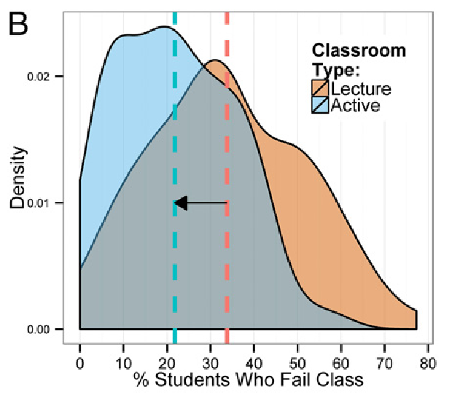
Active learning increases student performance in science, engineering, and mathematics
Meta analysis of 225 studies
Student performance on examinations and concept inventories increased by 0.47 SD
Students in classes with traditional lecturing were 1.5 times more likely to fail than those with active learning
https://math.stanford.edu/~conrad/papers/PNAS.pdf
Notes:
(weighted standardized mean difference of 0.47, Z = 9.781, P<<0.001). These results were consistent across disciplines: they observed no significant difference in the effects of active learning in biology, chemistry, computer science, engineering, geology, math, physics, and psychology course
f the experiments analyzed here had been conducted as randomized controlled trials of medical interventions, they may have been stopped for benefit—meaning that enrolling patients in the control condition might be discontinued because the treatment being tested was clearly more beneficial
additionally, all else being equal, active learning has been shown to decrease the achievement gap for underrepresented minorities and first generation college students

Slide 4
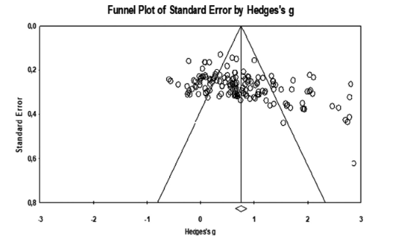
Active learning promotes a more positive attitudes towards the course [in schools]
Meta-analysis of 144 studies
Overall effect size for the effectiveness of active learning on attitudes towards the course (g = 0.757).
“properly implemented student-centred teaching will lead to more positive attitudes towars the course”
https://bera-journals.onlinelibrary.wiley.com/doi/epdf/10.1002/rev3.3346

Slide 5
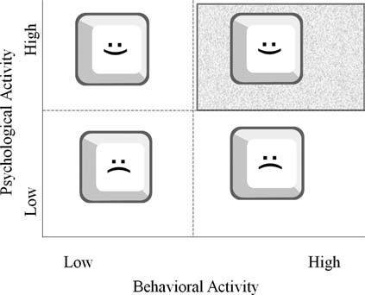
The Engagement Grid
Clark, Ruth C., and Richard E. Mayer. E-learning and the science of instruction. John Wiley & Sons, 2016.

Slide 6
Visible Learning
Visible Learning
Clark, Ruth C., and Richard E. Mayer. E-learning and the science of instruction. John Wiley & Sons, 2016.

Slide 7
Further Reading
Cynthia Brame. Active Learning. Vanderbilt
Freeman, Scott, et al. "Active learning increases student performance in science, engineering, and mathematics." Proceedings of the national academy of sciences 111.23 (2014): 8410-8415.
Ambrose, Susan A., et al. How learning works: Seven research-based principles for smart teaching. John Wiley & Sons, 2010.

