Slide 1
Synchronous computer-based tutorials
EEEN30072 Mobile Robots & Autonomous Systems (MRAS)
Dr Simon Watson
Senior Lecturer in Robotic Systems
Dept. of EEE
simon.watson@manchester.ac.uk

Slide 2
Overview
Course Aims: Provide a broad introduction to mobile robots and autonomous systems.
Cohort: ~60 - 70 3rd Year students (MTE only) [compulsory]
Asynchronous Material: ~30 minutes per week
Synchronous Sessions: 9 x 2 hours per session
Guest Sessions: 2 x 2 hours
Labs: 1 x 3 hours
Assessment: 1 x 3 hour online, open-world exam (70%)
1 x CPD video coursework on Robot Ethics (15%)
1 x Lab with Video Submission (15%)

Slide 3
History
Blended learning trials on legacy unit
All sessions are Blended
Specific synchronous activities (MATLAB based)
Asynchronous videos for all sessions
CPD based coursework
Use of MECD
2014-16
2016/17
2018/19
2020/21
2017/18
2019/20
2021/22
Unit is launched
5 out of 8 sessions are Blended
No asynchronous videos, just notes
No formal synchronous material, just working through tutorial questions from the notes (MATLAB based)
Classic closed-book paper exam and lab activities
Open-world, online exam
Year of Lockdown
Everything online
Open Zoom break-out rooms to replicate on-campus set-up
Video-based CPD coursework with transparent marking norms

Slide 4
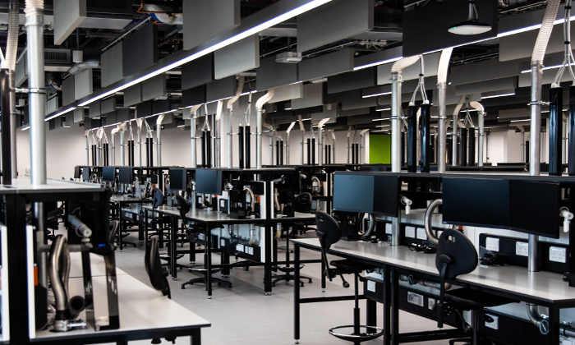
Session Structure
Asynchronous (lite): Student’s watch short videos (max 15 minutes total)
Synchronous Session Location: Dry Teaching Lab (MECD Eng B 2B.019)
Synchronous Session Structure:
0 – 5 mins: Welcome, introduction and announcements
5 – 20 mins: Review of high-level concepts through live demos / videos
  No review of the asynchronous videos or notes
  Essentially showing the end point of the concepts and how they are used
20 – 40 mins: Synchronous exercise 1
  Whilst these are being completed, wander around the lab answering questions / having discussions with the students
40 – 45 mins: Group discussion about exercise 1
  Show the results on screen and discuss any issues raised by students
45 – 100 mins: repeat above for remaining synchronous exercises

Slide 5
Student Feedback
“I really enjoyed the more hands on approach and felt like it helped me understand the content a lot more than just reading it out of a book” (17/18)
“I should also mention the new method of teaching where every lecture was basically a lab session was great. Having one course taught like this and another course taught the traditional way in a lecture theatre kept the semester varied, and I wished more courses would do something similar” (17/18)
“Great content, concise video but not too short up to the point you can’t learn anything. You learn a lot from a short period of time and leaves room for you to explore more”
“Open, friendly, encouraging, easy to talk to and respectful of students and their welfare. Kept asynchronous videos short and succinct and synchronous sessions engaging. Really interesting
material and made it relatable to what we know. Difficulty set at the right level and I always look forward to these lectures.” (20/21)
“I don't mind blended learning as long as its done in a way that isn't just a repeat of the videos. I like how the mobile robots module is executed as it provides practice and interactivity without repeating the videos” (21/22)

Slide 6
Format Analysis
Strengths
Students get to implement algorithms and concepts in a way they wouldn’t normally get to
Synchronous sessions build towards the exam at the end which is online, open-world and more effectively tests their knowledge and understanding rather than rote learning
Great way to get to know students
Weaknesses
Requires use of computers to access specialist software
Classic computer clusters are designed for 1 student per computer and make group work more challenging
  Bring Your Own Device (BYOD) would be good and allow use of large flat teaching spaces
  Issues with this around inclusivity
Scalability is challenging with current infrastructure

Slide 7
Future Plans
At the moment synchronous activities are discrete
  They all use the same software, but they don’t build upon each other
2022/23 Plans
  Introduction of new simulation software and synchronous exercises that will build upon each other, linking the topics more closely
2023 and Beyond
  Continuous assessment through the synchronous sessions and a modified exam/coursework split (50/50?)

Slide 8
Questions?

