Slide 1

Active Learning in Live Lectures
Improving Interaction and Engagement within large cohorts
Dr Charles Darko
| Lecturer in Polymer Science| Department of Materials

Slide 2
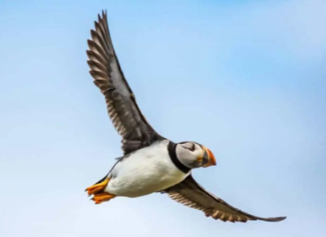
Preamble
Why do birds fly?
Picture source: Kennedy Wild Bird Food Ltd

Slide 3
Background
Large cohorts engagement and interaction
Difficulties
Large student numbers
Lack of more formative assessments
Lack of good subject knowledge of the lecturer
Lack of efficient information on Blackboard for feedforward approaches

Slide 4
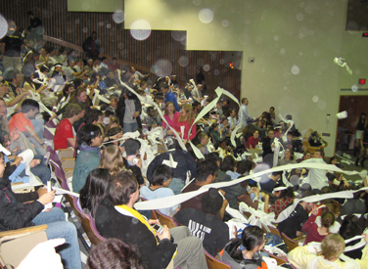
Background
Large cohorts engagement and interaction
Difficult in….
taking note
maintaining order
following rules
asking questions

Slide 5
Background
Active learning
Active & constructive learning means deep engaging (Vogel‐Walcutt, et al., 2011).
The more varied and integrated information, the more improvement in cognitive structures. (Wang et al., 2020)

Slide 6

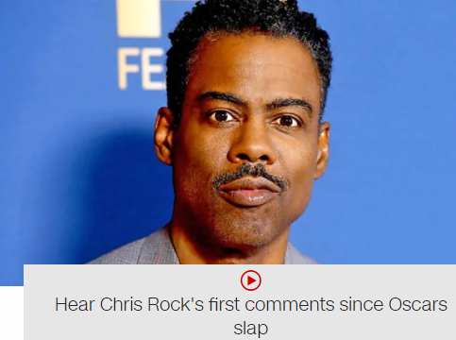
Main Discussions
Subject knowledge vs formative assessments
Outside Faculty of Science and Engineering
Some of the formative questions
Q. What are the current trending news in the world?
Source: RailFreight.com
Source: CNN

Slide 7
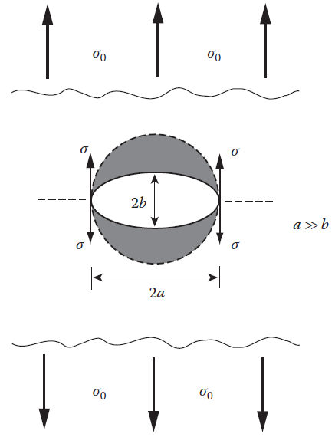
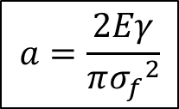
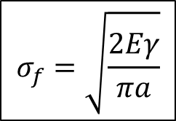
Main Discussions
Subject knowledge vs formative assessments
Within Faculty of Science and Engineering
Formative questions
1. Basic principle behind the Griffith law
The Griffith theory
2. Fracture stress
$$σ_{f}=\sqrt{\frac{2Eγ}{πa}}$$
3. Flaw sizes
$$a=\frac{2Eγ}{π{σ_{f}}^{2}}$$

Slide 8
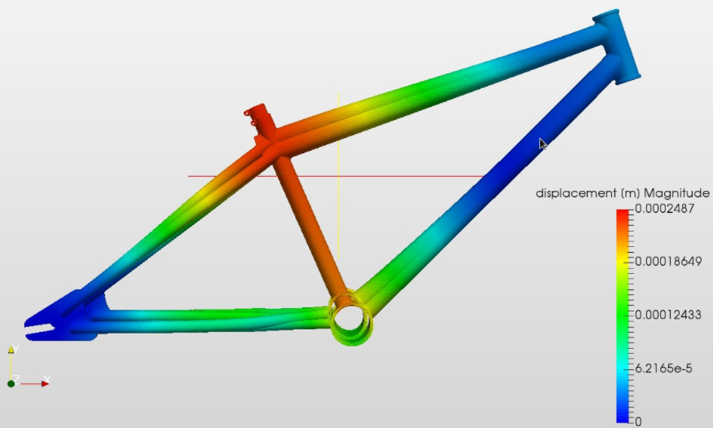
Main Discussions
Subject knowledge vs formative assessments
Within Faculty of Science and Engineering
Formative questions
1. What are the design parameters?
2. What are the steps in the material selections
3. Technology readiness level

Slide 9
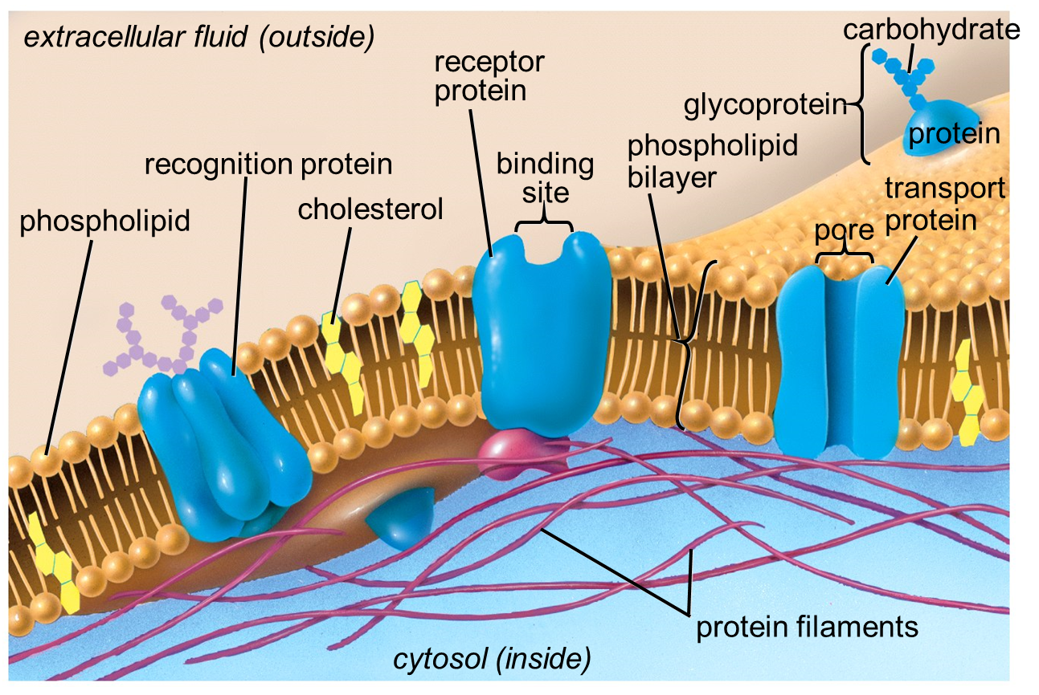
Main Discussions
Subject knowledge vs formative assessments
Within Faculty of Science and Engineering
The Fluid Mosaic model
Formative questions
1. Talk about phospholipid bilayer structure.
2. Talk about temperature influence.
3. Passive, Active and Vesicular transports

Slide 10
Main Discussions
Approaches to online students’ engagements
Within Faculty of Science and Engineering
Blackboard engagements

Slide 11
Main Discussions
Approaches to online students’ engagements
Within Faculty of Science and Engineering
Blackboard engagements
Higher level questions on Blackboard means students gets engaged and that create deep thinking.
Darko, C. (2021). An Evaluation of How Students Use Blackboard and the Possible Link to Their Grades. SAGE Open, 11(4), https://10.1177/21582440211067245.

Slide 12
Main Discussions
Approaches to online students’ engagements
Within Faculty of Science and Engineering
Designing online information for polymer science course
One size does not fit all.
First year students →learning something new.
Second year students → structure-property.
The third-year students→ structure-property and structure processing.
Darko, C. (2021). Improving Polymer Science Asynchronous Online Lecture Contents For Students’ Engagement. European Scientific Journal, 17(25), 95-115. https://doi.org/10.19044/esj.2021.v17n25p95

Slide 13
Take home message
Active learning summary
Learning →the creation of knowledge and conceptual development and can include the storing of knowledge in the brain and how it is used (Satzinger, 1998; Bartlett & Bartlett, 1995; Bernstein, 2018).
Learning →forming new schemas (i.e. a pattern of thought) and building upon previous schemas (Chalmers, 2003).
Learning → organization of schemas and adaptation of schemas. (McNamara, 1995).

Slide 14
Thank you
Any question?

